Slide 1
Business Area Report
Richard Brown, Business Area Director

Slide 2
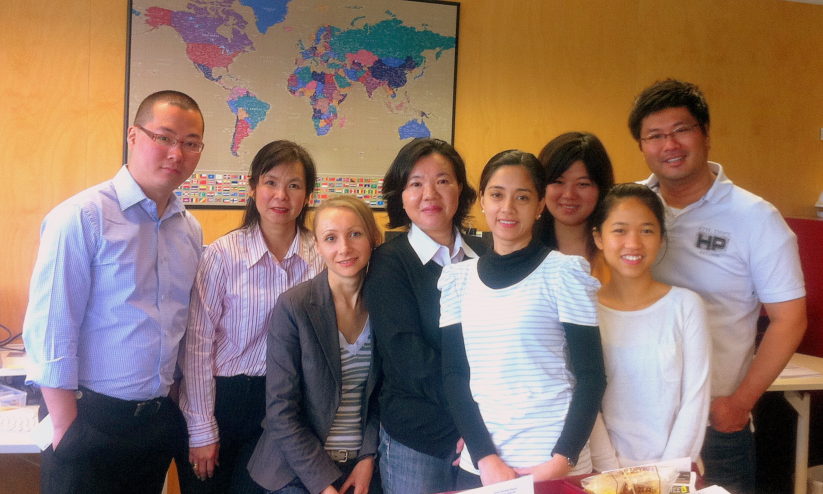
The Business Team

Slide 3
Key Deliverables
Corporate Support
Facilities & Office Management
Commercial & Financial Management
Operational Planning
Continuous Improvement
Business Continuity Planning

Slide 4
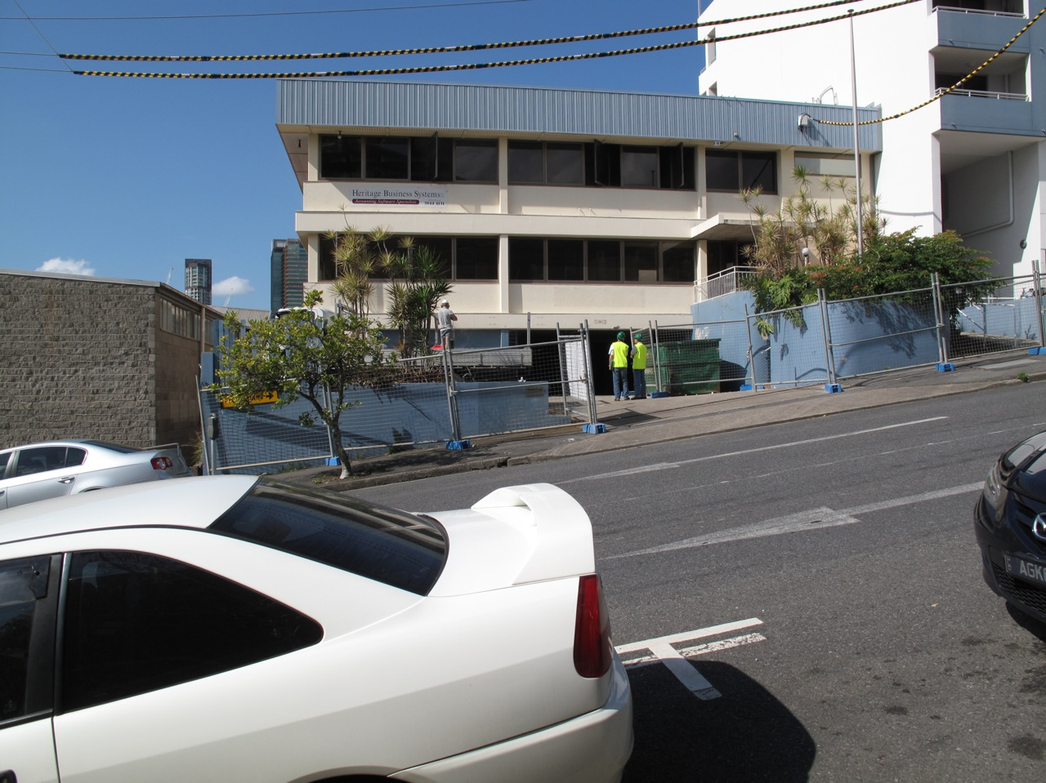
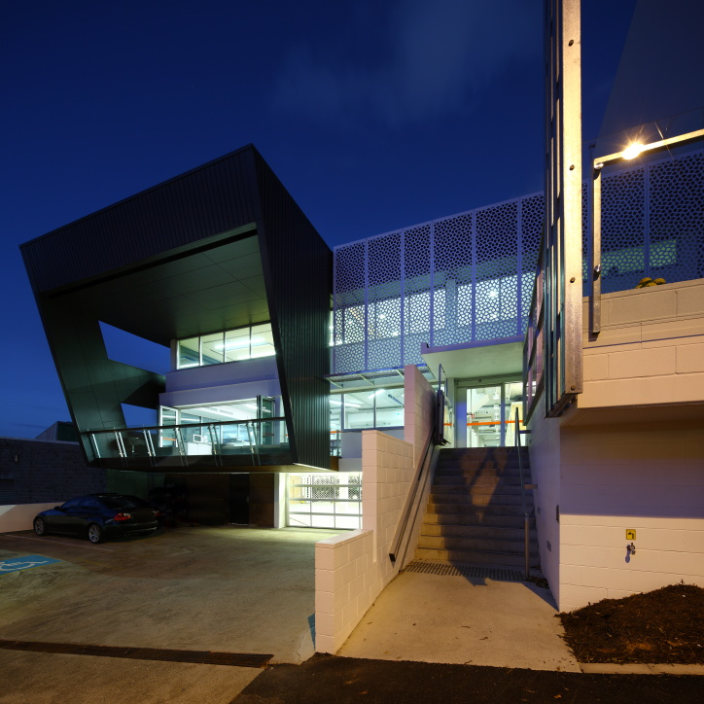
Facilities & Office Management
New office facilities
New premises – on-time, within budget

Slide 5
Facilities & Office Management
Old premises
60% of lease surrendered Mar 2011
Currently negotiating for another 16% for Oct 1
Actively marketing the remainder
Travel Management
Increasing volume of APNIC activities
Increase in trips by around 70% since 2008
Ongoing management and review of travel providers

Slide 6
Commercial Management
2011 mid-year budget review
Approved July EC Meeting
Membership growth exceeding forecasts
Revenue Up – Expenses Down
Review of insurances
Workshop to develop risk register
Report identifying potential risk exposures
Analysis of insurance coverage and gap identification
Ongoing risk management program

Slide 7
Operational Planning
2011 Full Planning Process
Starts after APNIC 32
Last Member Survey
EC strategic intent
Environmental analysis
Organizational assessment

Slide 8
Operational Plan
2012 Operational Plan
Priorities for Secretariat
Drilled down into individual performance targets
2012 Budget Submission

Slide 9
Continuous Improvement
Sourcing an Enterprise Resource Management (ERM) solution to align strategy, processes, people, technology, and knowledge

Slide 10
Continuous Improvement
High level requirements
Web based
High level of integration/redundancy
Automated workflow and audit trail
Change in organizational requirements
70 staff
Approaching 4000 accounts
Transaction volume and complexity increasing
Redundancy of operational applications critical

Slide 11
Continuous Improvement
New ERM System selection process
Agile methodology
Project team from Technical and Business Areas
Thorough analysis of system requirements
Shortlist and analysis of potential solutions
Final due diligence underway
Project plan currently being finalized
Implementation to begin Q4

Slide 12
Continuous Improvement
Functionality to be supported by the new ERM system:
HR and Payroll
Financial Accounting Suite
Travel and Expense Management
Management & Financial Reporting
Project/Activity Based Costing
Interface with APNIC Internal systems

Slide 13
Business Continuity Planning
Business Continuity Planning
Update of manuals 95% complete.
Audit to be completed Q4
Ongoing scenario testing - monthly
Regular and ongoing review
Focus on BCP reflected on all decisions

Slide 14
Information Society Innovation Fund
ISIF is a grants program aimed at stimulating creative solutions to ICT development needs in the Asia Pacific region:
19 projects from 10 AP economies, showcasing innovation, cooperation, and technical knowledge
Final reports from the 2010 grant recipients available for download.
ISIF award (AUD 7500 + IGF participation) launched in July, winners announced.
Stay tuned for changes in ISIF for 2012!

