Slide 1
APNIC Secretariat
Paul Wilson
Director General

Slide 2
APNIC Planning Process
Strategy / Activity Plan
Member Survey
Operational Plan
Budget
Membership
Secretariat
EC

Slide 3
Member and Stakeholder Survey
2011 Survey: EC Response
Active promotion of IPv6 deployment
Increase engagement with government
More community engagement on IPv4 transfers
Focus on APNIC’s registry function
Strengthen training activities
Ongoing attention to remote participation
Next: 2012
Launch in March (Delhi), Report August

Slide 4
Four Key Outcomes
Delivering Value
We are a service organization, providing value to all stakeholders according to their specific needs. We are funded by the membership, and manage resources in the mutual interest.
Internet Development
We support an open and neutral Internet, based on global addressability of all network components, and minimal barriers to global end-end reachability.

Slide 5
Four Key Outcomes
Collaborating and Communicating
We work within a global community of stakeholders, whose openness and cooperation is critical to the success of APNIC and of the Internet itself.
Corporate Support
The Secretariat exists to provide services, and support the activities of APNIC. It operates as a professional team with full accountability to the Members and stakeholders of APNIC

Slide 6
Major focus areas
IPv4: “Last /8” and beyond
IPv6 education, outreach, support
Global coordination
R&D becomes “Labs”
Efficiency, agility, continuity, security
A new identity…

Slide 8
Senior Team Building
Four existing Area Directors
Services, Communications, Technical, Business
New Directors…
Public Affairs – Pablo Hinojosa
Human Resources – Louise Tromp
And new additions…
Learning and Development Area – Philip Smith
General Counsel – Craig Ng

Slide 9
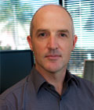
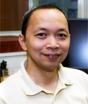
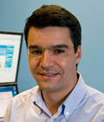
Executive Team
9

Slide 10
Thanks

