Slide 1
ARIN Update
Paul Vixie
APNIC 32 – Busan, Korea

Slide 2
2011 Focus
IPv4 Depletion & IPv6 Uptake
Developing, adapting, and improving processes and procedures
Working hard to keep pace with increased v6 requests and more complex v4 and transfer requests
Continue IPv6 outreach
Implementation of new policies and services
Continue development and integration of web-based system (ARIN Online)
DNSSEC and RPKI deployment
Continue participation in Internet Governance forums

Slide 3
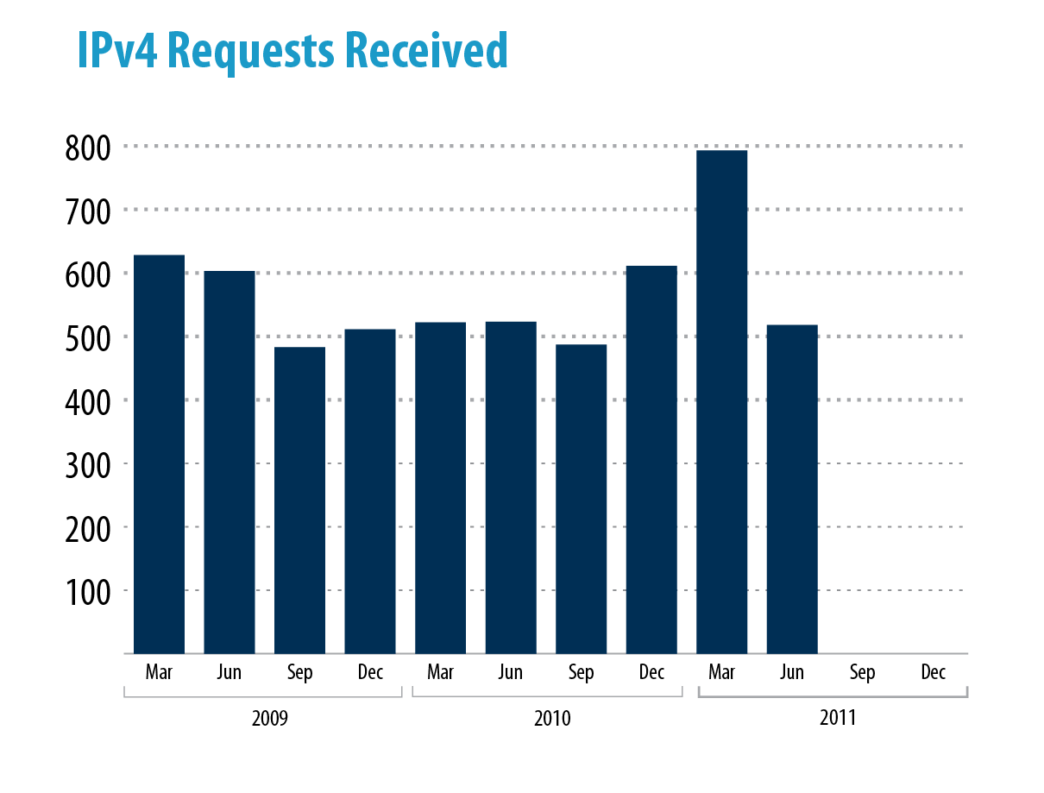
**Feb 3, 2011- IANA depletion
Notes:
https://www.arin.net/knowledge/statistics/index.html

Slide 4
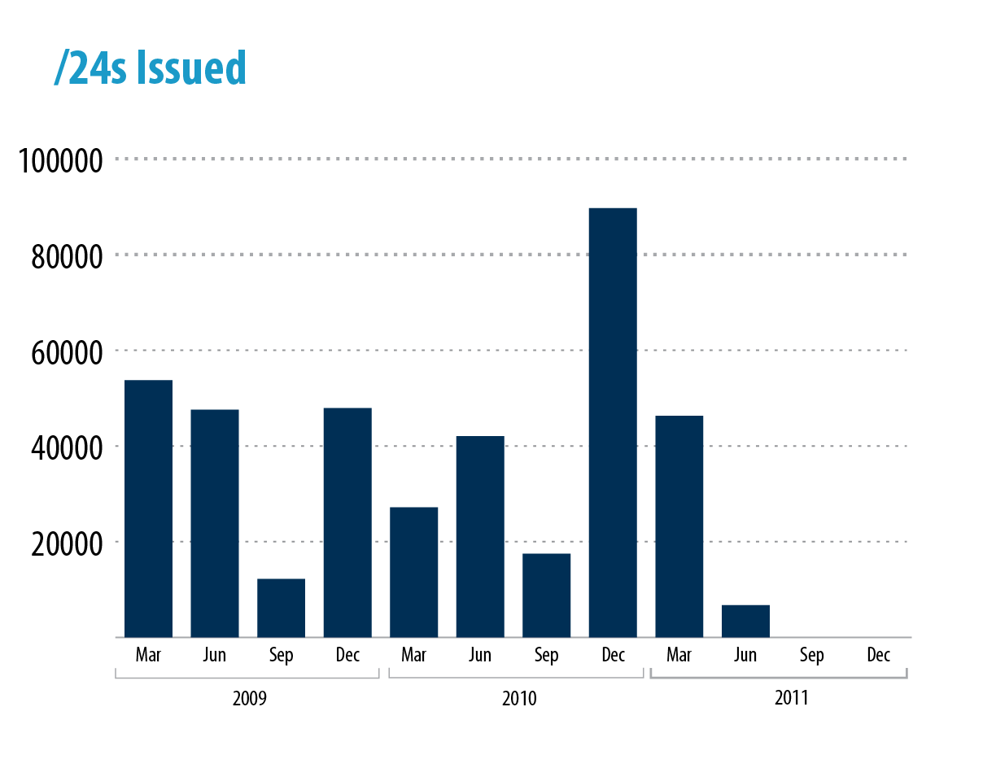

Slide 5
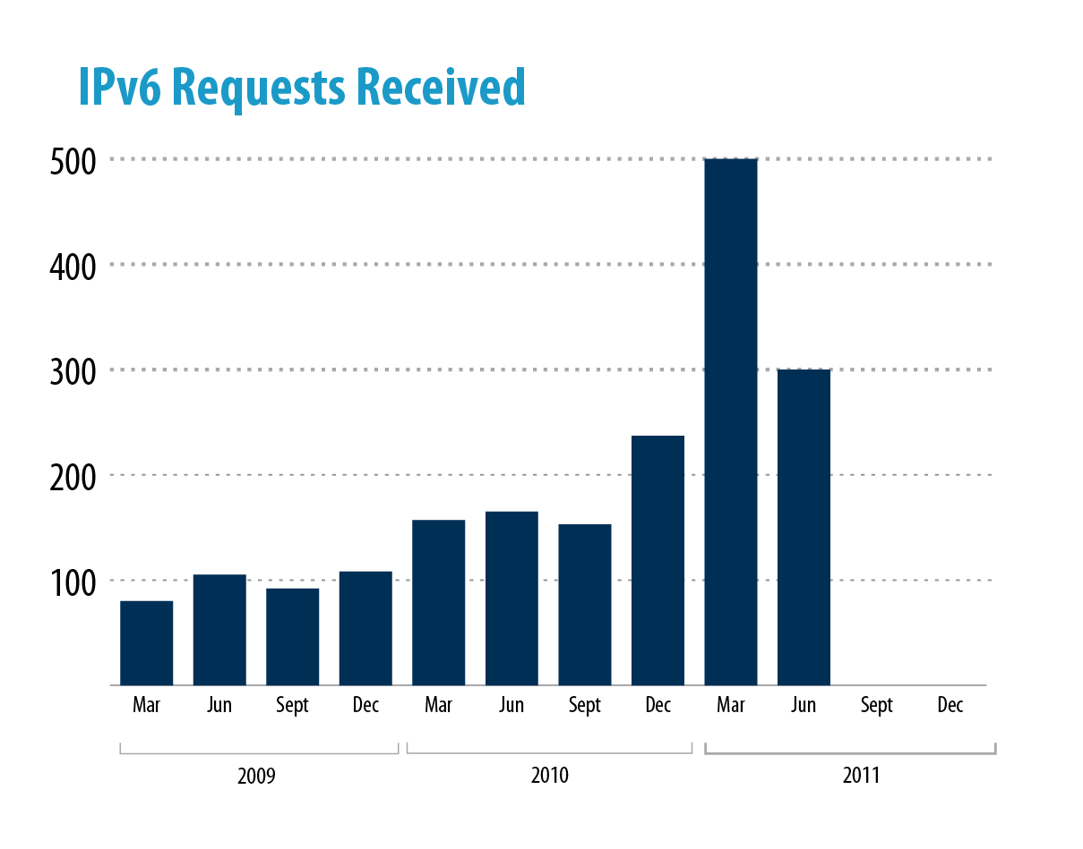
**Feb 3, 2011- IANA depletion

Slide 6
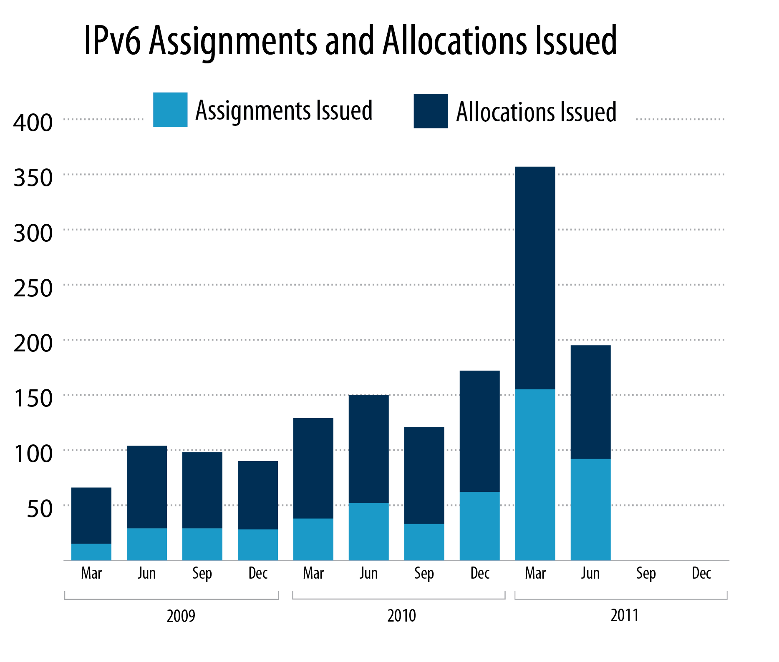

Slide 7
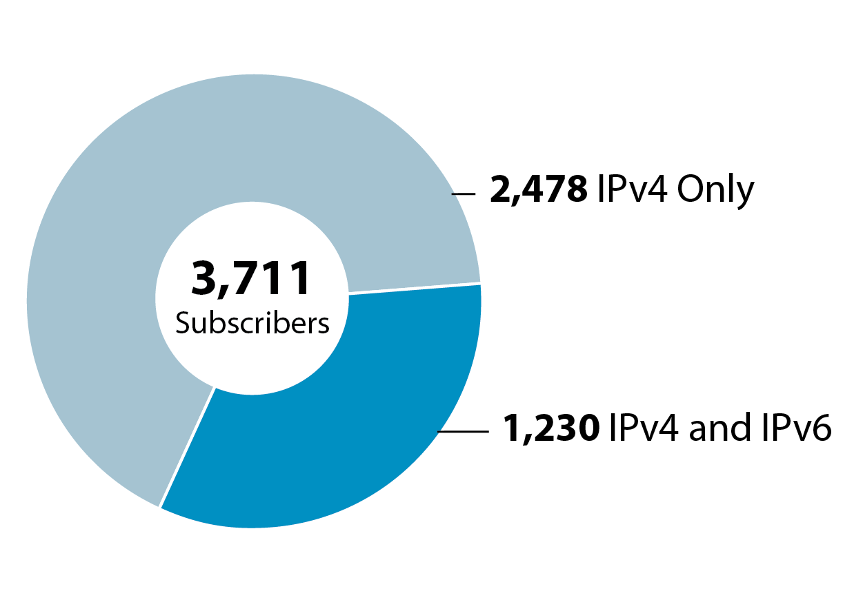
IPv4 vs. IPv6 Subscribers
3,711 IPv4 ISP subscribers today
2,478 (67%) do not have an IPv6 allocation.
*as of Aug 1, 2011

Slide 8
Recovered Resources 1 Jan 2005 – 15 August 2011
 | /16 equivalents | ASNs
Voluntary Returns | 459.87 | 1,590
Non-payment | 120.99 | 4,665
Fraud, misappropriation, business dissolution | 7.06 | 15

Slide 9
Recently Implemented Policy
ARIN-2010-14: Standardize IP Reassignment Registration Requirements
Expands the “cable IPv4 allocation policy” to all ISPs with residential/DHCP-type customers (lowers utilization threshold, increases utilization information requirements)
Requires SWIP for /64 and larger static reassignments

Slide 10
Adopted/to be Implemented
ARIN-2011-3: Better IPv6 Allocations for ISPs
Would enable ISPs to request larger blocks of IPv6 space on nibble boundaries
To be implemented no later than 15 February 2012
Notes:
To be implemented no later than 15 February 2012

Slide 11
Current Proposals
4 Active Draft Policies
9 Policy Proposals
Available at:
https://www.arin.net/policy/proposals/
Notes:
Accurate on 17 August 2011

Slide 12
Proposal Highlights
ARIN-2011-1: Globally Coordinated Transfer Policy
Would allow transfers to/from the ARIN region
The two RIRs must have compatible transfer policy
Need required (transfers are needs-based)
ARIN-2011-5: Shared Transition Space for IPv4 Address Extension
Creates an IPv4 /10 to be shared (eg. draft-shirasaki-nat444-03 )
Under ARIN Board review. Board tasked ARIN to work with the IETF/IAB.
Reached consensus in the IETF WG (opsawg).

Slide 13
Highlights (cont.)
ARIN-prop-137 Global Policy for post exhaustion IPv4 allocation mechanisms by the IANA
Instructs IANA to accept returned address space and reissue that space to the RIRs (a 1/5th portion to each RIR every 6 months)
ARIN-prop-151 Limiting Needs Requirements for IPv4 Transfers
Removes the needs-based evaluation from transfers to specified recipients
ARIN-prop-155 IPv4 Number Resources for Use Within Region
“IPv4 addresses are issued solely for use in networks within the ARIN region.”
Applies to new requests after it’s implemented
Notes:
Similar to 6to4

Slide 14
Public Facing Development Efforts
ARIN Online
Billing integration
Billing and contact information now in ARIN Online
Invoice reminders in ARIN Online in Q3
Specified transfers occur through ARIN Online
Templates and corresponding RESTful modules protected by API Keys
IRR to be rolled out August 30 (adding CRYPT-PW, PGP, and email notification of object updates)
Value Added Security Services
RPKI
Hosted to be completed in Q4 of 2011
Delegated to be done in Q1 of 2012
DNSSEC
Done, fully operational

Slide 15
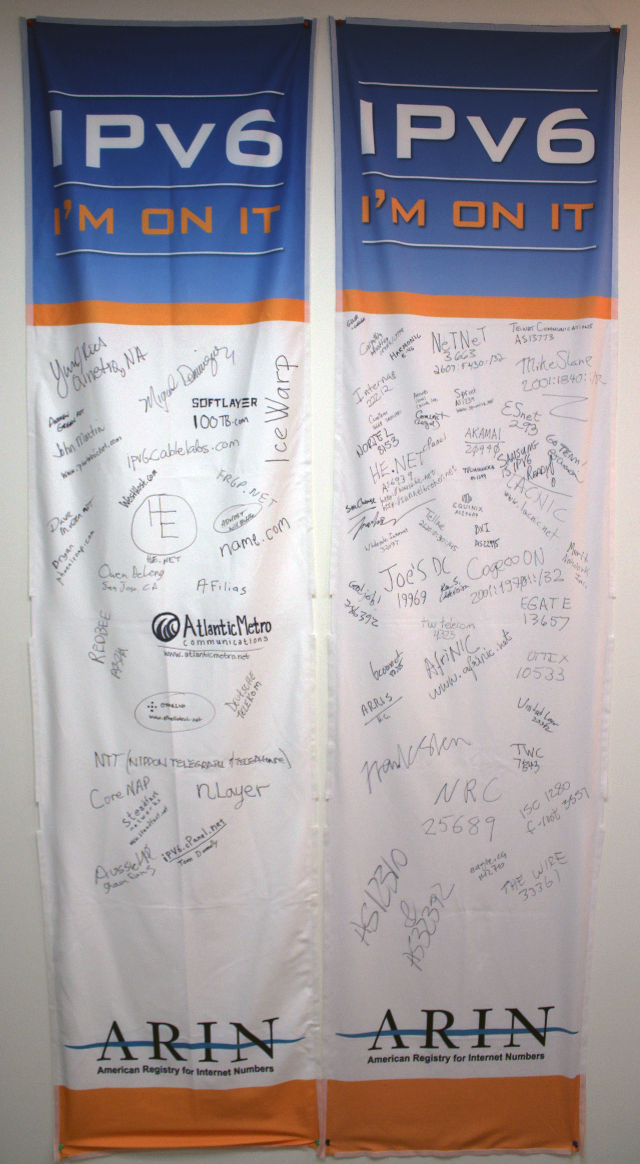
2011 Outreach Events
Ongoing participation in various local, national and international forums, focus on IPv4 depletion and IPv6 adoption. Events include:
ARIN on the Road (Boston, San Jose, Montreal)
Pacific Telecom Conference
Cable Labs
Joint Techs / Internet2
ICT Roadshow Events
IT Roadmap
Game Developers Conference
Enterprise Connect
Rocky Mountain IPv6 Summit
Interop
CANTO
FOSE
HostingCON

Slide 16
Upcoming ARIN Meetings
Network Sponsor
Network Sponsor

