Slide 1
IANA Update @ APNIC 32, Busan
Elise Gerich
VP IANA

Slide 2
IANA RFP
48 FNOI responses received
The US DoC NTIA will publish an RFP for the IANA Functions
Guestimates
RFP probably published mid-September
NTIA decision potentially early 2012

Slide 3
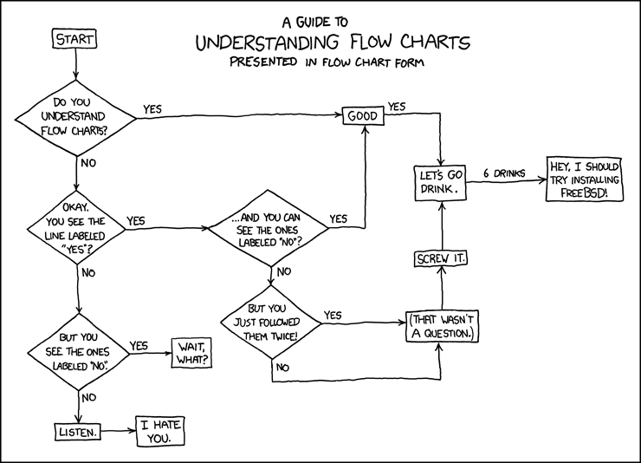
Business Excellence 2010-11
We’ve converted the documentation for our core processes to a single standard format
We’ve reviewed our KPIs
We’re setting new performance targets
Used under a CC BY-NC 2.5 license from xkcd.com
Notes:
Key KPIs and targets
Area KPI Target
IETF Transparency Requester always knows the status of the request 100% IETF Reporting Deliver monthly reports on time 100% Root Zone Accuracy Is the request implemented perfectly? 100%
RIRs Timeliness &
Process Quality Number of iterations with the RIR 2 or fewer

Slide 4
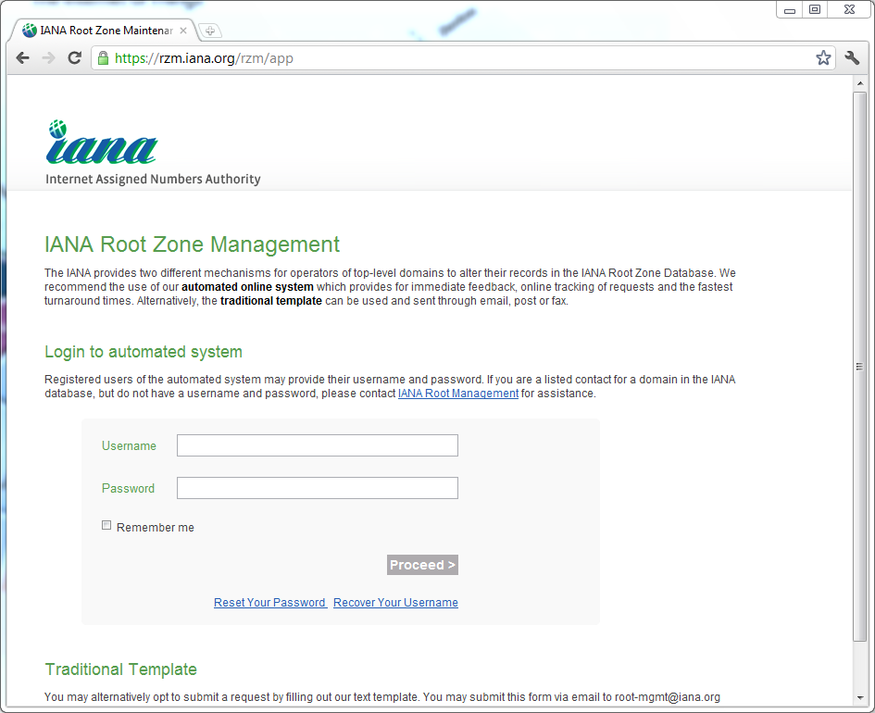
Root zone automation
The new web interface to root zone management was launched in August
Credentials for the system are being distributed in 5 tranches of TLD
20% of TLDs already have their credentials
Notes:
23 requests were processed through RZM. This involves completed, administratively closed and withdrawn requests for data changes, name server changes, DS records changes and redelegations.
Currently open requests in RZM: 17

Slide 5
Cooperating with the RIRs
IANA & RIRs are working on clarifying the process for IPv6 allocation requests
Meaning of “reserved” in IPv6 sparse allocation context
Key goals include
Automation
Transparency

Slide 6
Other good stuff
Achieved SysTrust accreditation for DNSSEC
Met & exceeded the SLA target for protocol parameter assignments for IETF
MCAST.NET delegated to new nameservers & DNSSEC signed
Notes:
1st org to achieve SysTrust accreditation for DNSSEC
The overall SLA target agreed with the IETF is for 95% of requests to be completed within the agreed timeframe. We have not only hit the target we have exceeded it (98%) on more than one occasion.
MCAST.NET is the domain used to give some IPv4 multicast assignments DNS names. In order to improve the resilience of the zone, it was redelegated to a set of nameservers managed by ICANN’s DNS Ops group and signed with DNSSEC. Separately from this, Leo and Joe have been working with Peter Koch (DENIC) on an I-D (draft-ietf-mboned-mcast-arpa) that would migrate MCAST.NET to MCAST.ARPA and introduce IPv6 support. That work is going on in the IETF’s MBONED WG.

Slide 7
감사합니다
Notes:
Thank you

Slide 8
질문이 있으십니까?
Notes:
Questions?

