Slide 1
Treasurer’s Report
APNIC 32
Busan, South Korea

Slide 2
Overview
Implemented New Non-Member Fee Schedule
Financial status Year To Date June 2011
Reported surplus: AUD $1.4m
Revenue: AUD $7.4m
Expenditure: AUD $6.0m
Membership growth
242 first half 2011 (+27%) (2010: + 8%)
2,763 members as at 30 June 2011

Slide 3
Projected Financial Status 2011
Forecast surplus: AUD $1.0m
Forecast revenue:
AUD $15.0m (budget was $14.4m)
4.5% above budget
Forecast expenditure:
AUD $14.0m (budget was $14.2m)
1% below budget

Slide 4
Operating Profit/ (Loss)
Operating Profit / (Loss) (AUD) | Budget 2011 | Forecast 2011 | ∆% | YTD June 2011 | YTD June 2010 | ∆%
Total Revenue | 14,439,105 | 15,089,254 | 4.5% | 7,428,811 | 6,459,907 | 15.0%
Total Expenses | 14,235,123 | 14,098,072 | -1.0% | 6,035,680 | 5,598,414 | 7.8%
OPERATING PROFIT | 203,982 | 991,181 |  | 1,393,131 | 861,492
Notes:
4

Slide 5
Mid Year Review
Initial budget was breakeven
EC at it’s face to face meeting (dec) made changes:
ERM (enterprise resource management) Project
Staff Legal position
Revised budget was then surplus of $200k
EC noted general uncertainty of v4 exhaustion on revenue
During mid year review, surplus greater, projects approved

Slide 6
Balance Sheet as at 30 June 2011
Financial Position (AUD) | June 2011 | Year-End 2010 | ∆%
Current Assets | 8,047,579 | 7,679,724 | 4.8%
Non-current Assets | 9,870,225 | 9,528,170 | 3.6%
TOTAL ASSETS | 17,917,805 | 17,207,895 | 4.1%
Total Liabilities | 7,563,332 | 8,192,397 | -7.7%
Total Equity | 10,354,473 | 9,015,497 | 14.9%
TOTAL LIABILITIES & EQUITY | 17,917,805 | 17,207,895 | 4.1%
Notes:
6

Slide 7
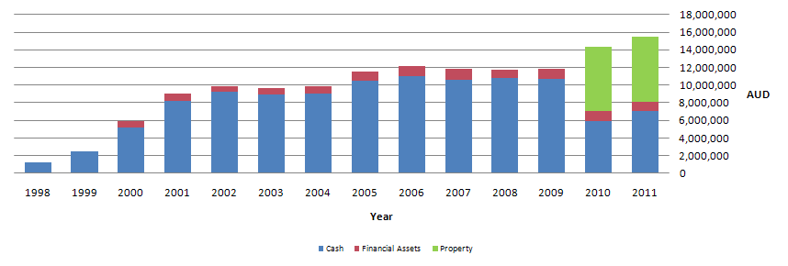
APNIC Reserve

Slide 8
Questions?

