Slide 1
APNIC 32 AMM Policy SIG Report
Andy Linton
Thursday 1 September 2011
Notes:
Taken over the policy function
Support the community PDP by working with the Chair
Keep Secretariat staff up-to-date
Maintain the website and documentation

Slide 2
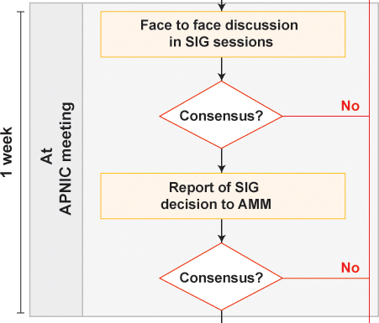
Policy Development Process
We are here

Slide 3
Review of IPv6 Policy
Now in ‘Stage 3’ of IPv4 Exhaustion
IPv6 Policy now the main area of interest
Undertake a high-level review of IPv6 policies
More details soon on Mailing List
Subscribe at www.apnic.net/policy-sig

Slide 4
Global Policy Prop-069
Action Item: pol-27-02
Pending approval at each remaining stage of the policy development process, the APNIC Secretariat to implement prop-69, "Global policy proposal for the allocation of IPv4 blocks to Regional Internet Registries," with the following clarifications:
The minimum size for redistributions by IANA to be explicitly documented
Examples of how IANA would redistribute space to the RIRs to be added

Slide 5
Global Policy Prop-069
The membership of the APNIC Policy SIG recognizes that Prop-069 - Global policy proposal for the allocation of IPv4 blocks to Regional Internet Registries has been been superseded by Prop-097 and that Prop-069 should be abandoned.

Slide 6
Proposals under Discussion
prop-096: Maintaining demonstrated needs requirement in transfer policy after the final /8 phase
prop-098: Optimizing IPv6 allocation strategies (simplified)
prop-099: IPv6 Reservation for Large Networks
prop-100: National IP Address Plan - Allocation of country-wide IP address blocks

Slide 7
prop-096 Maintaining demonstrated needs requirement in transfer policy after the final /8 phase
Problems this proposal aims to address:
APNIC is the only RIR that does not require a demonstrated need for transfers.
Other RIRs are reluctant to recognize any inter-RIR transfer policy with APNIC.

Slide 8
prop-096 Maintaining demonstrated needs requirement in transfer policy after the final /8 phase
Proposed solution:
It is proposed that recipients of transfers be required to justify their need for IPv4 address space.
Consensus Reached in SIG. Require AMM

Slide 9
prop-096 Maintaining demonstrated needs requirement in transfer policy after the final /8 phase
Action:
pol-32-01: Pending approval at each remaining stage of the policy proposal process, APNIC Secretariat to implement proposal prop-098, “Maintaining demonstrated needs requirement in transfer policy after the final /8 phase”.

Slide 10
prop-098 Optimizing IPv6 allocation strategies (simplified)
Problems this proposal aims to address:
LIRs feel they must fit their entire subscriber base in a single /32.
Network outages caused by bit math errors. This will lead to disaggregation.
The HD ratio leaves much to be desired as an address administration tool.

Slide 11
prop-098 Optimizing IPv6 allocation strategies (simplified)
Proposed solution:
Utilization be measured in ‘Provider Allocation Units’ - smallest reassignment unit
75% or more utilization, or
One or more facilities has reached a 90% utilization and no blocks available to expand

Slide 12
prop-098 Optimizing IPv6 allocation strategies (simplified)
Proposed solution:
Allow LIRs to request nibble-aligned blocks of any size greater than or equal to /36
Default minimum is /32
Maximum to accommodate 5 years
Subordinate LIR block count as fully utilized

Slide 13
prop-098 Optimizing IPv6 allocation strategies (simplified)
Proposed solution:
Subsequent allocations expand to the next nibble – existing allocation can be re-sized
Allocation shall not exceed a /16, but, a provider may receive multiple /16s to meet justified needs
LIR is ‘encouraged’ to vacate their old allocations

Slide 14
prop-098 Optimizing IPv6 allocation strategies (simplified)
Action:
pol-32-02: prop-098, “Optimizing IPv6 allocation strategies (simplified)”, returned to the mailing list for further discussion.

Slide 15
prop-099 IPv6 Reservation for Large Network
Proposed solution:
Reservation request for projected network growth up to 10 years
Long-term network plans
Environmental factors

Slide 16
prop-099 IPv6 Reservation for Large Network
Proposed solution:
Reservation expires after 2 years unless re-justified
Allocated prefixes registered in whois
Reservation documented separately

Slide 17
prop-099 IPv6 Reservation for Large Network
Action:
pol-32-03: prop-099, “IPv6 Reservation for Large Network”, returned to the mailing list for further discussion.

Slide 18
prop-100 National IP Address Plan - Allocation of country-wide IP address blocks
Problems this proposal aims to address:
APNIC policy does not allow address blocks to be allocated at the economy level
This proposal calls for adequate IPv6 address space per economy be reserved for future allocations to organizations and stakeholders within that economy.

Slide 19
prop-100 National IP Address Plan - Allocation of country-wide IP address blocks
Proposed solution:
Analysis and Projection of Requirements
Reservation of the IPv6 address space for different economies by APNIC

Slide 20
prop-100 National IP Address Plan - Allocation of country-wide IP address blocks
Action:
pol-32-04: prop-0100, “National IP Address Plan - Allocation of country-wide IP address blocks”, returned to the mailing list for further discussion.

Slide 21
Thank you

