Slide 1
APNIC Research Report
Geoff Huston
Chief Scientist

Slide 2
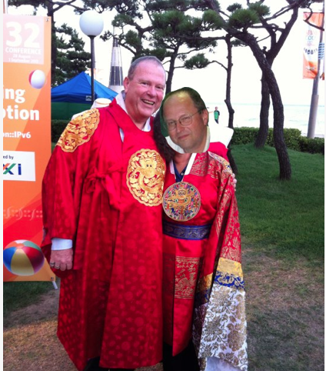
Meet our team
(With apologies
to Elise and
George!)

Slide 3
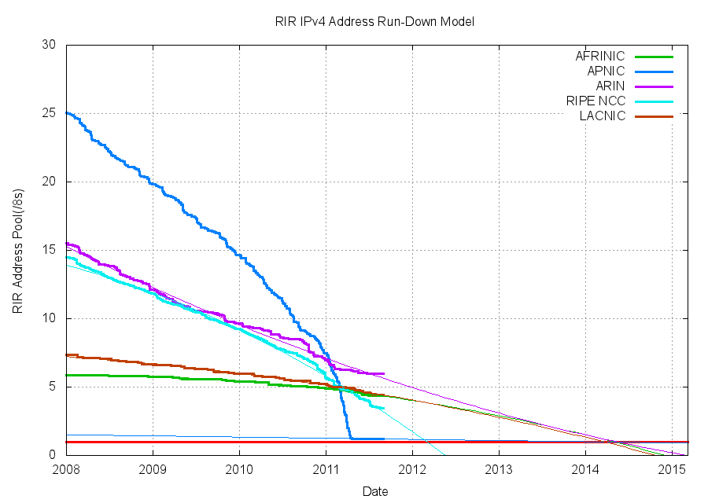
From the labs....
IPv4 Exhaustion
When? Why? How?
What does it mean?

Slide 4
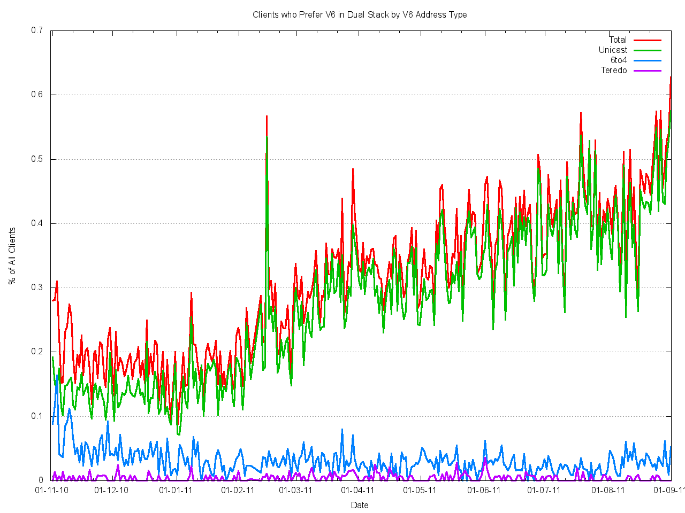
From the labs...
IPv6 Deployment Measurements
How well are we doing?
What is going on?

Slide 5
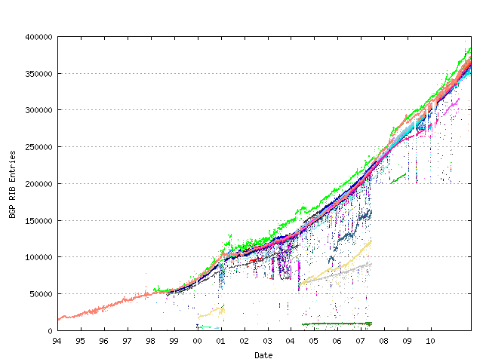
From the labs...
BGP Measurements
    Is routing scaling? What is the underlying drivers for the growth in routing? Can we secure routing?

Slide 6
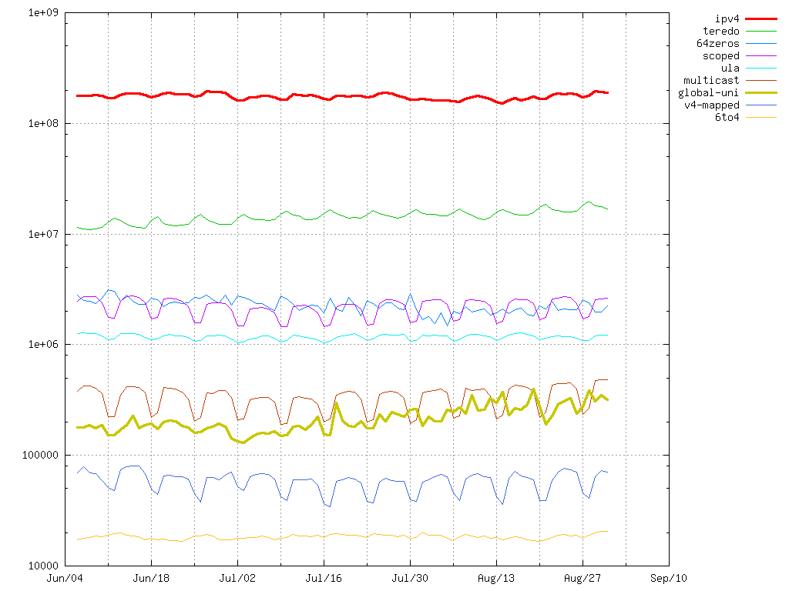
From the labs...
Reverse DNS measurements
Impact of DNSSEC. DNS Scaling.
What does it mean?

Slide 7
Where to find us
We are moving to...
labs.apnic.net

