Slide 1
Technical Area Report
Byron Ellacott, Technical Area Director

Slide 2
Key Deliverables
Delivering Value
Taken full load on e.in-addr-servers.arpa and e.ip6-servers.arpa
Rapid deployment of Australian DNS anycast node
Submitted DNSSEC DS records to IANA
Added large anycast service provider for reverse DNS zones

Slide 3
Key Deliverables
Delivering Value
Improvements to change management and software testing practices
Adoption of Agile software testing practices
Supporting Internet Development
Supporting R&D with remote IPv6 measurement techniques

Slide 4
Key Deliverables
Corporate Support
Deployed load balancers between Australian facilities
Supporting APNIC business with modelling and process management

Slide 5
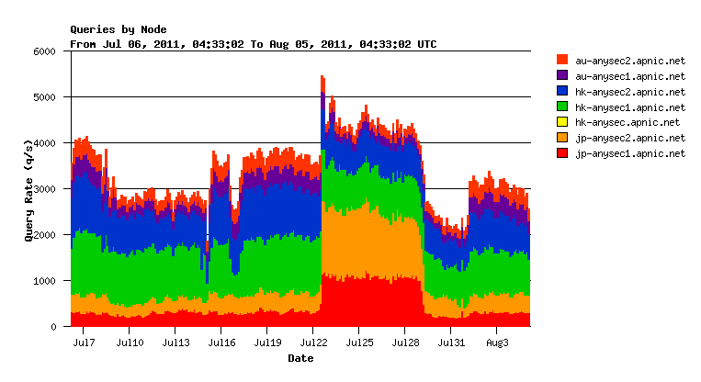
Serving e.in-addr and e.ip6
APNIC now serving e.in-addr-servers.arpa and e.ip6-servers.arpa. labels.

Slide 6
Serving e.in-addr and e.ip6
Transitioned and successfully taken on full load from 8 March 2011
Servers handling about 3,000 queries per second

Slide 7
DNS Anycast Node
Successfully built a rapid deployment anycast node in Australia for DNS
In response to Japan disaster
Completed in under two weeks

Slide 8
DS Records to IANA
Submitted Delegation Signer (DS) to IANA
APNIC submitted regional DS records to IANA on 3 May 2011, extending DNSSEC validation chains down to APNIC’s zones.

Slide 9
Anycast to Reverse DNS
Added large anycast service provider to reverse DNS zones
Notes:
Provides highly distributed, resilient, and low latency service for region’s reverse DNS data
apnic1.dnsnode.net enabled
About ¼ of queries served by this cloud

Slide 10
Improved Testing Practices
Improvements to software testing practices
Automated unit testing and reporting improvements
Greater use of tools for testing and preparing for continuous integration
Improvements to change management practices
Following industry best practices

Slide 11
Agile
Adoption of Agile software development methodologies
Improved reporting capabilities, increased communication and information sharing
Provides greater software quality, test-driven development
Guided by continuous integration principles

Slide 12
Agile

Slide 13
APNIC Labs
Supporting R&D with remote measurement techniques
Software expertise provided for cost effective and broad measurement of client-side IPv6 capability measurements
Provides rich data on client capabilities
Offers website operators tools to measure own audience via Google Analytics suite
http://labs.apnic.net

Slide 14
APNIC Labs

Slide 15
Modelling and Process Management
Expertise provided in modelling and documenting processes, identifying bottlenecks and opportunities for improved efficiency
Use of industry standard process modelling systems such as BPM

Slide 16
Thank You

